Slide 1
E6156 – Topics in SW Engineering (F23) Cloud Computing Lecture 2a: Microservices, REST, BLOBs
© Donald F. Ferguson, 2023

Slide 2
E6156 – Topics in SW Engineering (F23) Cloud Computing Lecture 2a: Microservices, REST, BLOBs
We will start in a minute or two.
© Donald F. Ferguson, 2023

Slide 3

Contents
3 | E6156 – Topics in SW Engineering: Cloud Computing: Lecture 2a – Microservices, REST, BLOBs © Donald F. Ferguson, 2023

Slide 4
Some Concepts
4 | E6156 – Topics in SW Engineering: Cloud Computing: Lecture 2a – Microservices, REST, BLOBs © Donald F. Ferguson, 2023

Slide 5
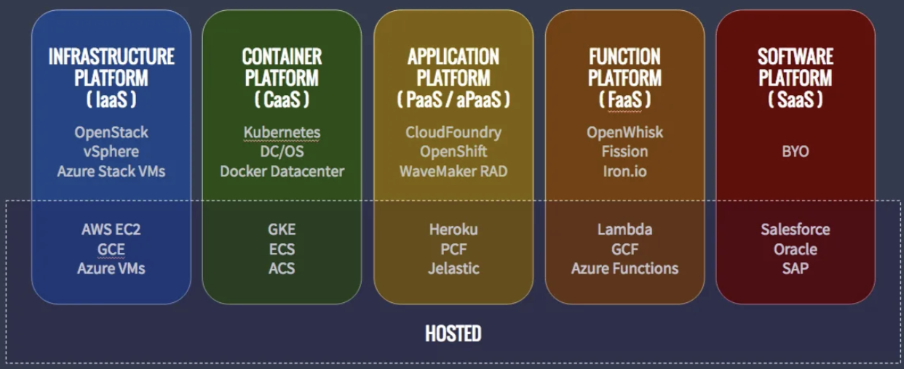

Cloud Computing “Layers:” One Perspective
”Integrate” “Deploy”
Repo
”Publish” “Share”
https://medium.com/@nnilesh7756/what-are-cloud-computing-services-iaas-caas-paas-faas-saas-ac0f6022d36e
Develop
We are seeing a recurring pattern: develop/test, publish/share, deploy.
We have seen two examples:
Develop → GitHub → Deploy (EC2)
Develop → Container Registry → Deploy (EC2+Docker)
We have been doing some things manually, e.g. provision, configure, deploy.
We will see new models (e.g. - PaaS, DaaS, FaaS) and automation (e.g. CI/CD, infrastructure as code, GitHub Actions, …)

Slide 6
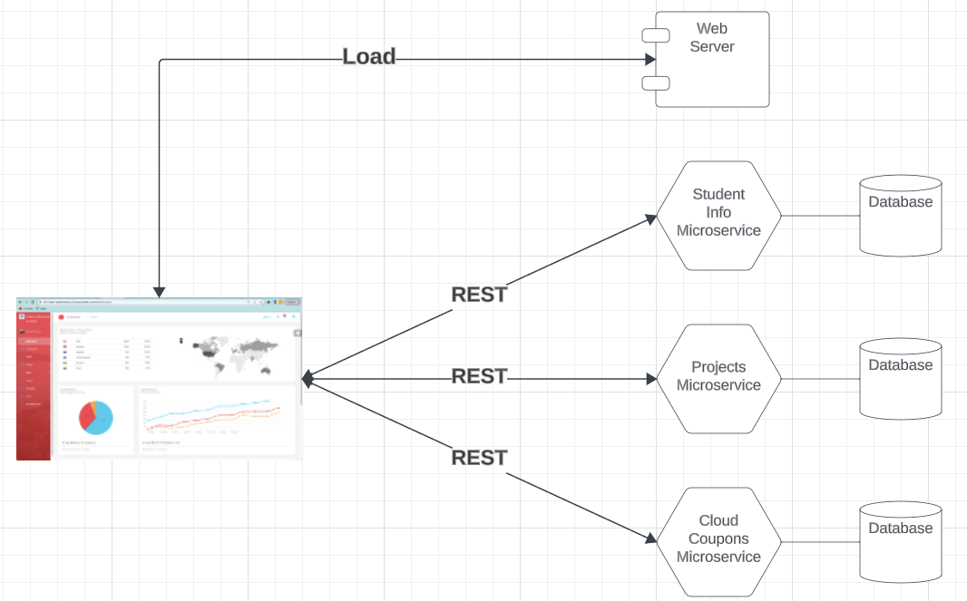
Next Sprint for Professor – You Will Mirror
Sprint 1:
Set up master project and sprint board.
Basic structure and process for 4 sub-projects.
Web UI Portal.
Student profile and information.
Student team, project information.
Cloud coupon, accounts, etc. info.
End-to-end flow for “Hello world” in each element.
4 deployment models:
S3 for web UI portal.
PaaS (Elastic Beanstalk) for student.
Container for cloud coupons.
IaaS for student info.
Sprint 2:
Add single sign on via OAuth2.
Add data and databases.
Single, consolidate API and API gateway.
First deployment automation.
Will try Google App Engine
https://cloud.google.com/appengine/docs/standard/python3/building-app/deploying-web-service

Slide 7
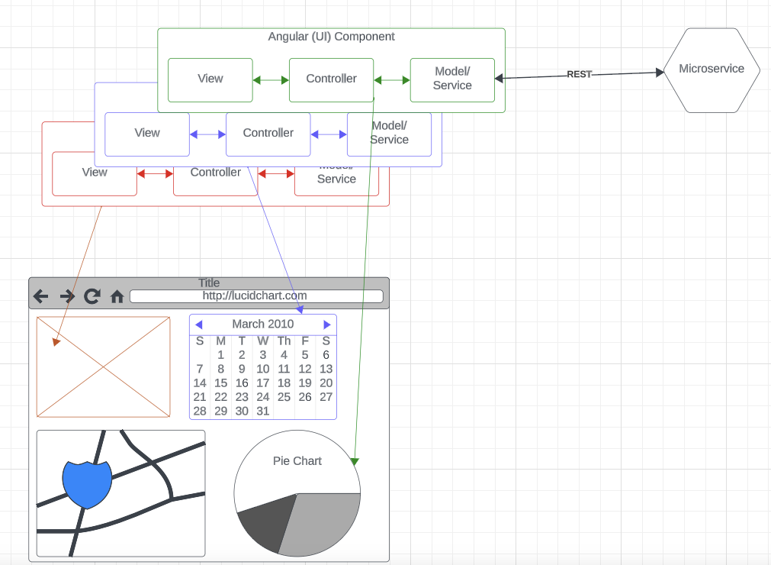
Web UI
There are several models and frameworks for UI
Model-View-Controller
View-Model-View Model
Angular
React
… …
Not a focus of this course but will show simple examples so you understand this aspect of “full stack” and end-to-end applications.

Slide 8
Microservices Continued
8 | E6156 – Topics in SW Engineering: Cloud Computing: Lecture 2a – Microservices, REST, BLOBs © Donald F. Ferguson, 2023

Slide 9
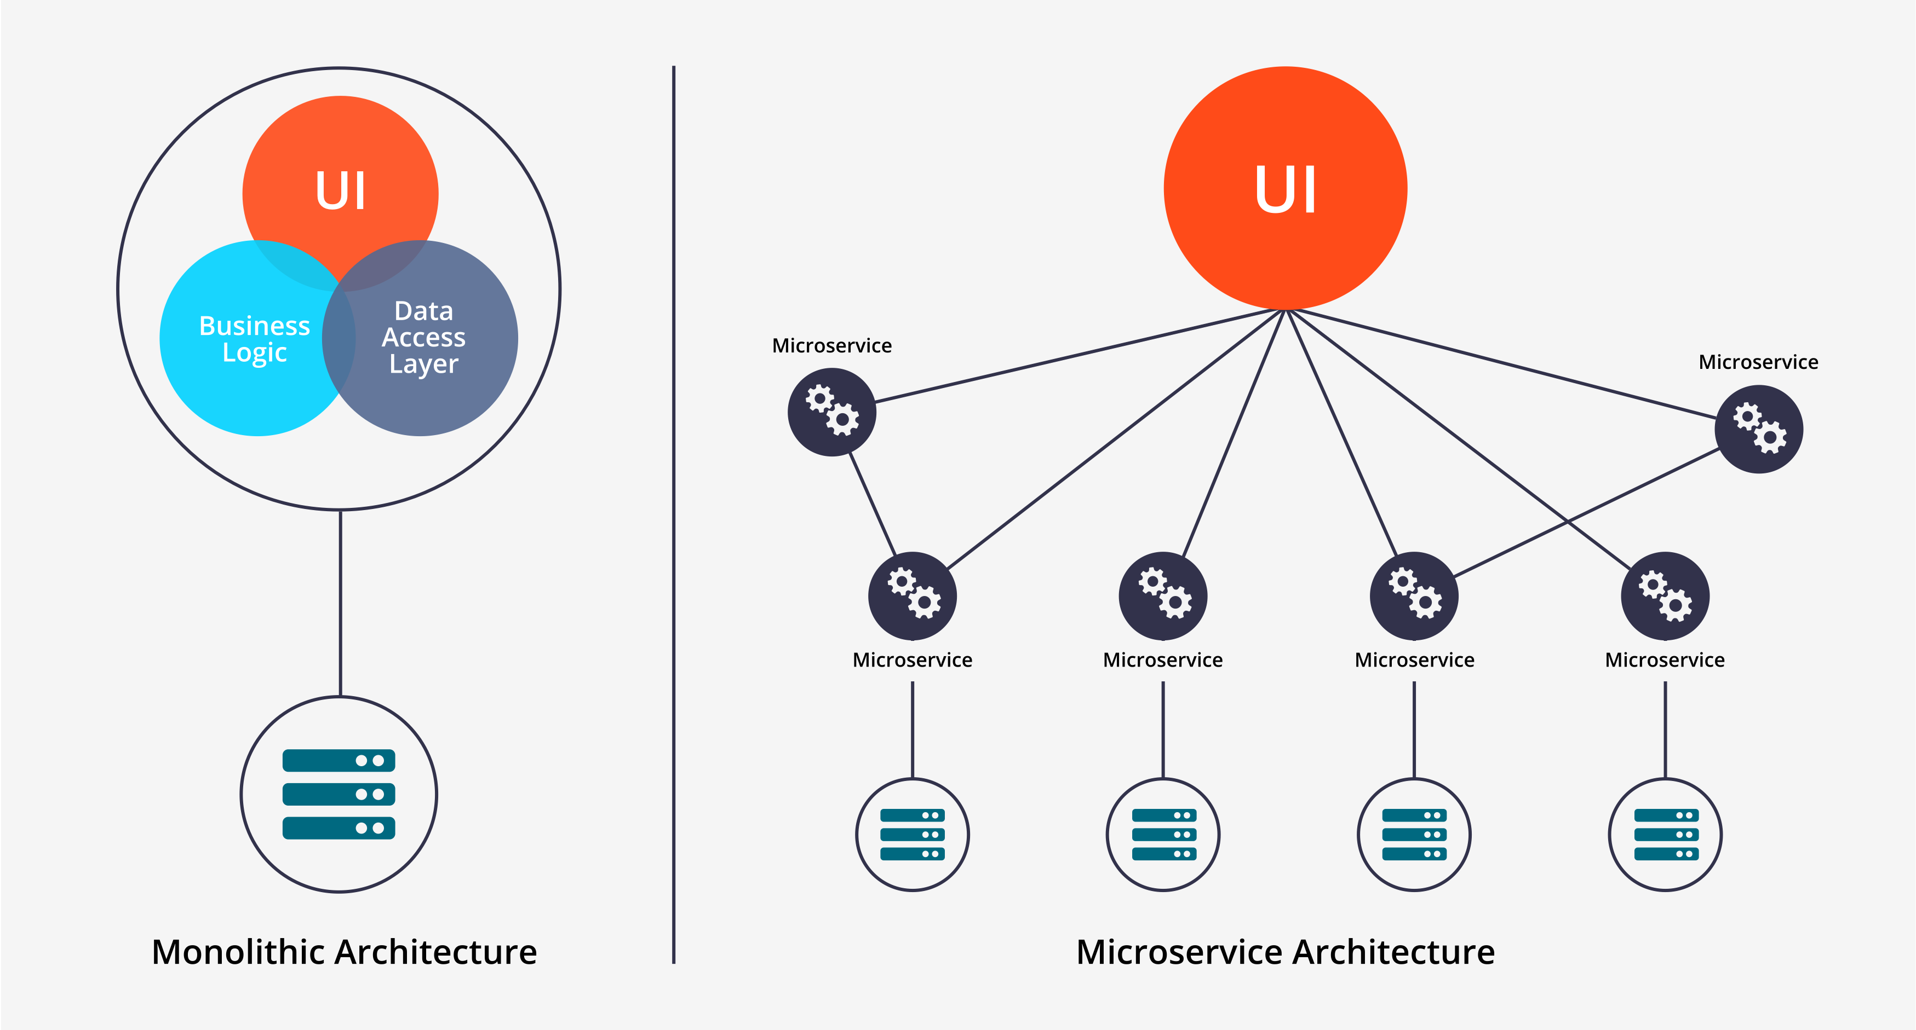
Microservices
Historically, complex applications were implemented and deployed as “one big application.”
Monolith Architecture is built in one large system and usually one code-base. A monolith is often deployed all at once, both front-end and back-end code together, regardless of what was changed.
Microservices Architecture is built as a suite of small services, each with their own code-base. These services are built around specific capabilities and are usually independently deployable.
Components of Microservices architecture:
The services are independent, small, and loosely coupled
Encapsulates a business or customer scenario
Every service is a different codebase
Services can be independently deployed
Services interact with each other using APIs
https://medium.com/hengky-sanjaya-blog/monolith-vs-microservices-b3953650dfd

Slide 10
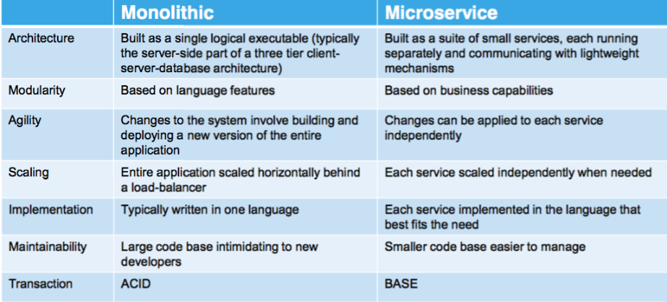
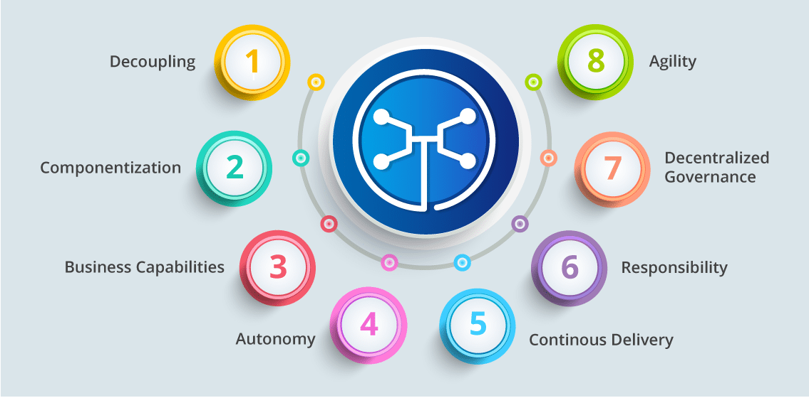
Microservices
You can drive yourself crazy trying to:
Compare microservice architectures to other architecture patterns.
Define the characteristics of microservices. What makes something a microservice?
Why do I cover microservices?
It does have benefits in large scale SW development projects.
It looks “cool” on your resume.

Slide 11
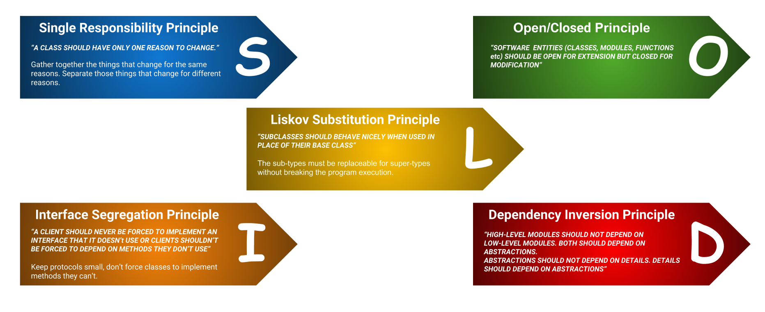
SOLID Principles
“In software engineering, SOLID is a mnemonic acronym for five design principles intended to make software designs more understandable, flexible, and maintainable. ” (https://en.wikipedia.org/wiki/SOLID)
The concept started with OO but applies to microservices.
We will focus on the “S” for now.
For my project purposes, a thing can be:
A user profile service
Or
A commerce catalog service
Or
...
But not both.

Slide 12
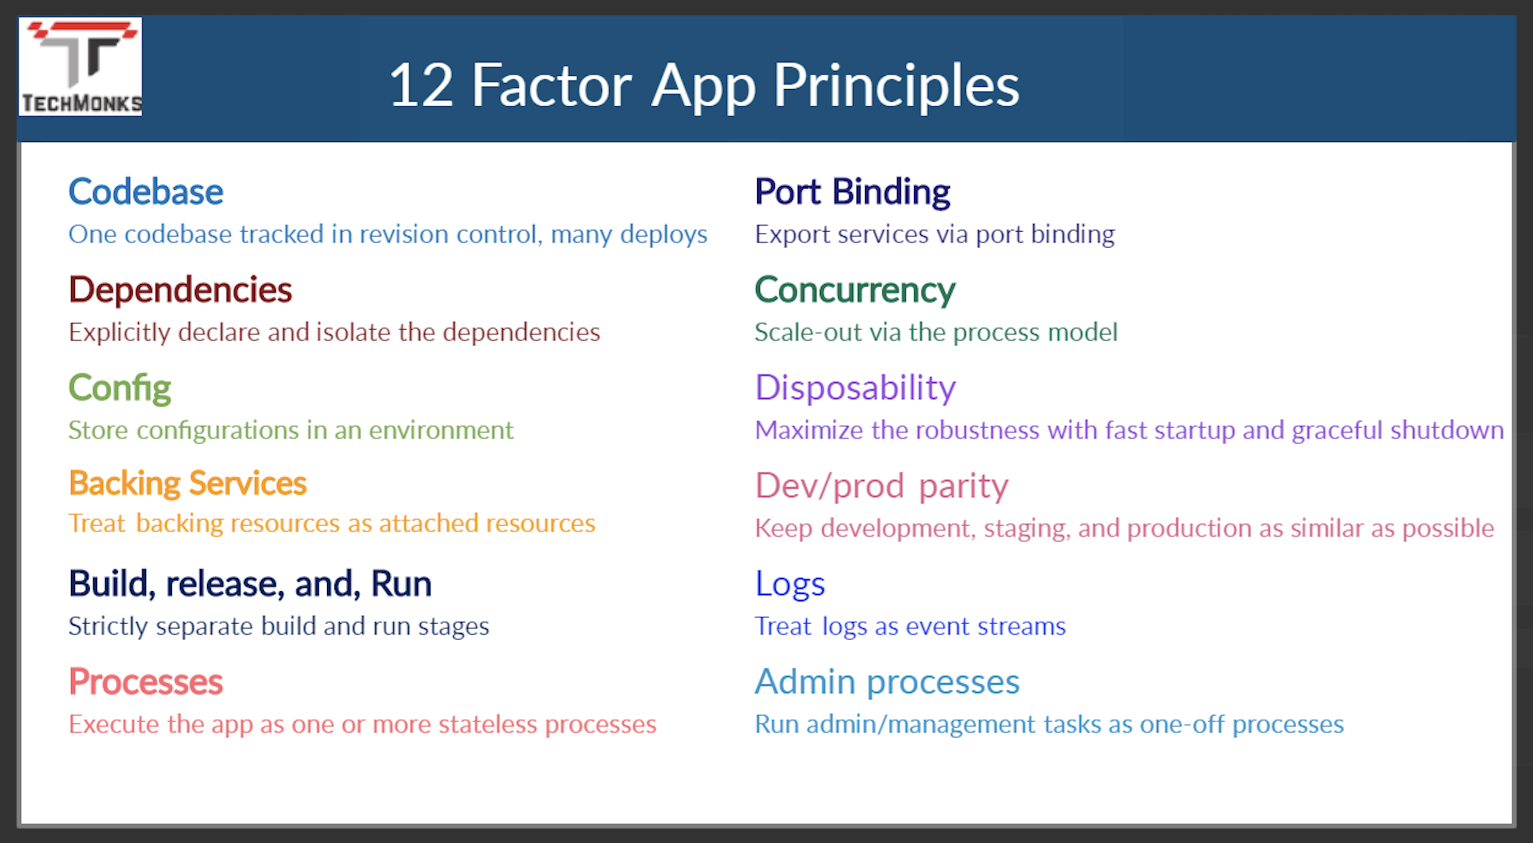
12 Factor Applications
https://dzone.com/articles/12-factor-app-principles-and-cloud-native-microser

Slide 13
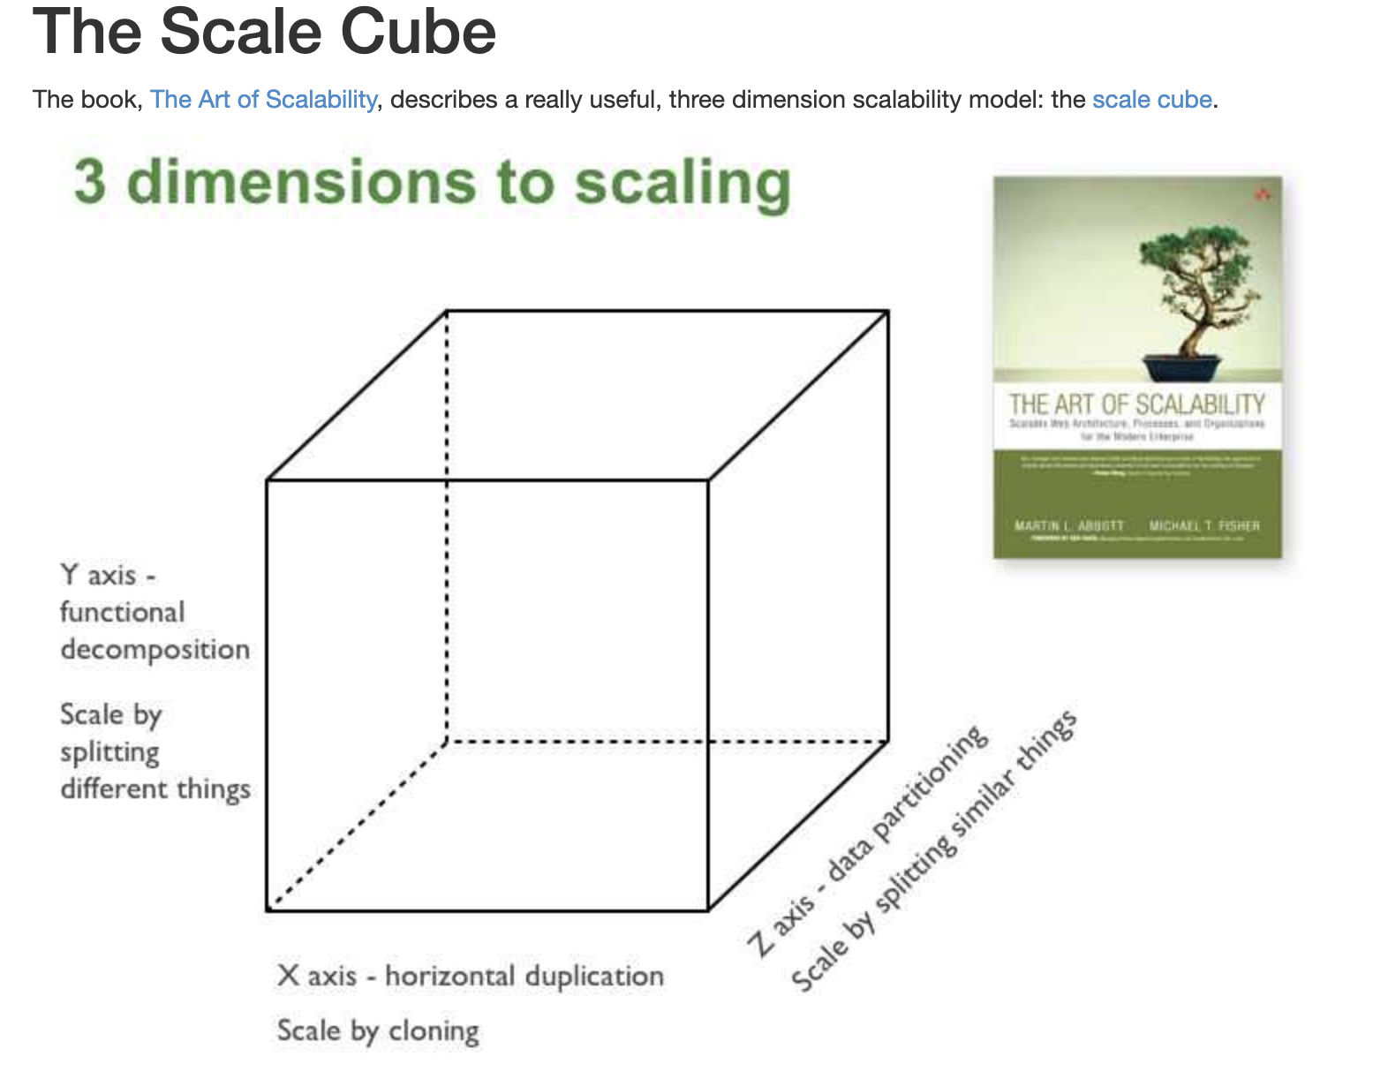
Microservices Scalability Cube
https://microservices.io/articles/scalecube.html
X-axis scaling consists of running multiple copies of an application behind a load balancer. If there are N copies then each copy handles 1/N of the load. This is a simple, commonly used approach of scaling an application.
Y-axis axis scaling splits the application into multiple, different services. Each service is responsible for one or more closely related functions.
When using Z-axis scaling each server runs an identical copy of the code. In this respect, it’s similar to X-axis scaling. The big difference is that each server is responsible for only a subset of the data. Some component of the system is responsible for routing each request to the appropriate server

Slide 14
XYZ – Scaling
There are three dimensions.
A complete solution/environment typical is a mix and composition of patterns.
Application design and data access determines opitions.

Slide 15
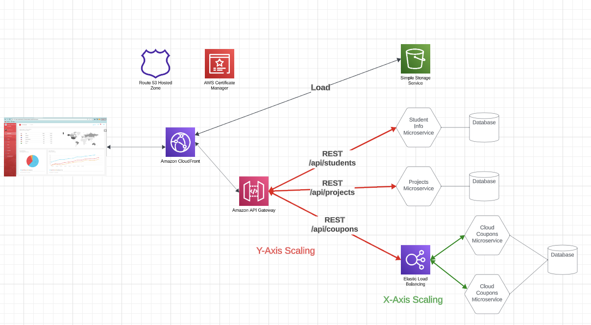
How Will We Apply Scaling Patterns
API GW routing and multiple microservice implement Y-Axis Scaling
I will show how to use Elastic Load Balancer and Target Groups for X-Axis Scaling but you will not have to do it.
Just understand Z-Axis Scaling.
Inherent scaling and performance comes from S3, CloudFront, … …
Will show some of the networking to get better URLs, e.g. Route 53, Certificate Manager

Slide 16
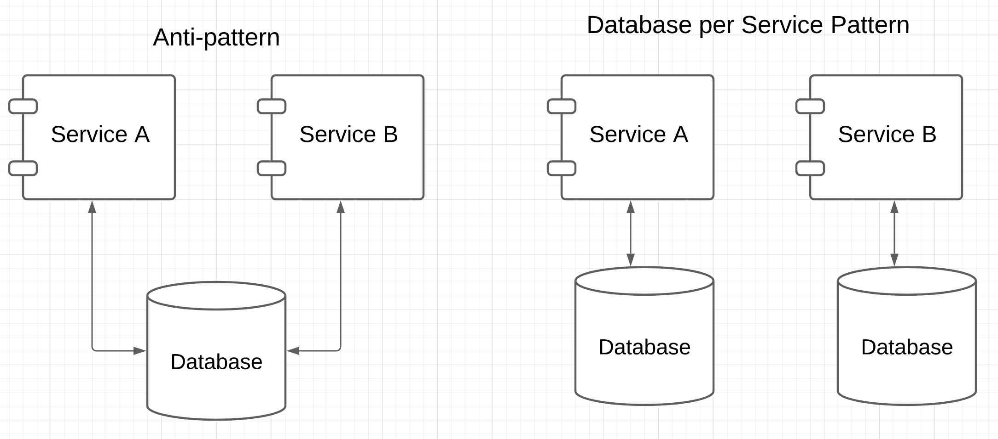

Patterns and Anti-patterns
“software design pattern is a general, reusable solution to a commonly occurring problem within a given context in software design. It is not a finished design that can be transformed directly into source or machine code. Rather, it is a description or template for how to solve a problem that can be used in many different situations.” (https://en.wikipedia.org/wiki/Software_design_pattern)
“An anti-pattern is a common response to a recurring problem that is usually ineffective and risks being highly counterproductive.” (https://en.wikipedia.org/wiki/Anti-pattern)
https://microservices.io/patterns/data/database-per-service.html
Prevents independent evolution by creating dependency.

Slide 17
Patterns and Anti-patterns
“software design pattern is a general, reusable solution to a commonly occurring problem within a given context in software design. It is not a finished design that can be transformed directly into source or machine code. Rather, it is a description or template for how to solve a problem that can be used in many different situations.” (https://en.wikipedia.org/wiki/Software_design_pattern)
“An anti-pattern is a common response to a recurring problem that is usually ineffective and risks being highly counterproductive.” (https://en.wikipedia.org/wiki/Anti-pattern)
The question of “why?” has arisen. There are online discussions of pros and cons.
https://docs.aws.amazon.com/prescriptive-guidance/latest/modernization-data-persistence/database-per-service.html
https://microservices.io/patterns/data/database-per-service.html
https://www.tutorialspoint.com/microservices_design_patterns/microservices_design_patterns_database_per_service.htm
https://microservices.io/patterns/data/database-per-service.html
Prevents independent evolution by creating dependency.

Slide 18
REST, Part I
18 | E6156 – Topics in SW Engineering: Cloud Computing: Lecture 2a – Microservices, REST, BLOBs © Donald F. Ferguson, 2023

Slide 19

Concepts
19 | E6156 – Topics in SW Engineering: Cloud Computing: Lecture 2a – Microservices, REST, BLOBs © Donald F. Ferguson, 2023

Slide 20
REST (https://restfulapi.net/)
What is REST
REST is acronym for REpresentational State Transfer. It is architectural style for distributed hypermedia systems and was first presented by Roy Fielding in 2000 in his famous dissertation.
Like any other architectural style, REST also does have it’s own 6 guiding constraints which must be satisfied if an interface needs to be referred as RESTful. These principles are listed below.
Guiding Principles of REST
Client–server – By separating the user interface concerns from the data storage concerns, we improve the portability of the user interface across multiple platforms and improve scalability by simplifying the server components.
Stateless – Each request from client to server must contain all of the information necessary to understand the request, and cannot take advantage of any stored context on the server. Session state is therefore kept entirely on the client.
Cacheable – Cache constraints require that the data within a response to a request be implicitly or explicitly labeled as cacheable or non-cacheable. If a response is cacheable, then a client cache is given the right to reuse that response data for later, equivalent requests.
Uniform interface – By applying the software engineering principle of generality to the component interface, the overall system architecture is simplified and the visibility of interactions is improved. In order to obtain a uniform interface, multiple architectural constraints are needed to guide the behavior of components. REST is defined by four interface constraints: identification of resources; manipulation of resources through representations; self-descriptive messages; and, hypermedia as the engine of application state.
Layered system – The layered system style allows an architecture to be composed of hierarchical layers by constraining component behavior such that each component cannot “see” beyond the immediate layer with which they are interacting.
Code on demand (optional) – REST allows client functionality to be extended by downloading and executing code in the form of applets or scripts. This simplifies clients by reducing the number of features required to be pre-implemented.

Slide 21
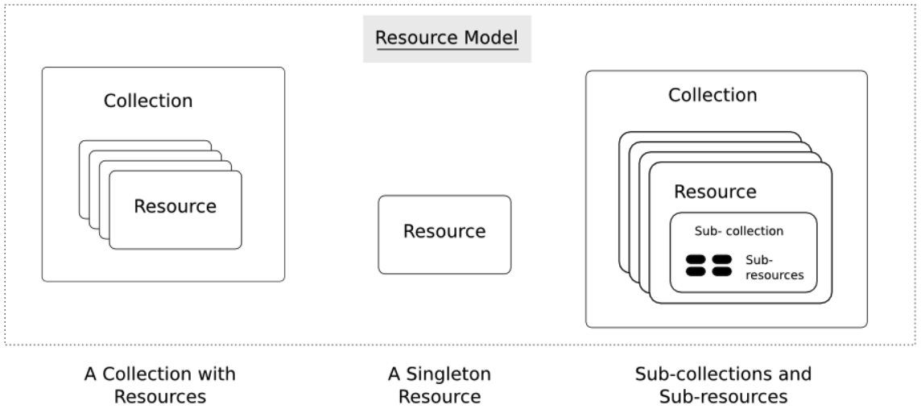
Resources
Resources are an abstraction. The application maps to create things and actions.
“A resource-oriented API is generally modeled as a resource hierarchy, where each node is either a simple resource or a collection resource. For convenience, they are often called a resource and a collection, respectively.
A collection contains a list of resources of the same type. For example, a user has a collection of contacts.
A resource has some state and zero or more sub-resources. Each sub-resource can be either a simple resource or a collection resource.
For example, Gmail API has a collection of users, each user has a collection of messages, a collection of threads, a collection of labels, a profile resource, and several setting resources.
While there is some conceptual alignment between storage systems and REST APIs, a service with a resource-oriented API is not necessarily a database, and has enormous flexibility in how it interprets resources and methods. For example, creating a calendar event (resource) may create additional events for attendees, send email invitations to attendees, reserve conference rooms, and update video conference schedules. (Emphasis added) (https://cloud.google.com/apis/design/resources#resources)
https://restful-api-design.readthedocs.io/en/latest/resources.html

Slide 22
REST – Resource Oriented
When writing applications, we are used to writing functions or methods:
openAccount(last_name, first_name, tax_payer_id)
account.deposit(deposit_amount)
account.close()
We can create and implement whatever functions we need.
REST only allows four methods:
POST: Create a resource
GET: Retrieve a resource
PUT: Update a resource
DELETE: Delete a resource
That’s it. That’s all you get.
A REST client needs no prior knowledge about how to interact with any particular application or server beyond a generic understanding of hypermedia.
“The key characteristic of a resource-oriented API is that it emphasizes resources (data model) over the methods performed on the resources (functionality). A typical resource-oriented API exposes a large number of resources with a small number of methods.” (https://cloud.google.com/apis/design/resources)

Slide 23
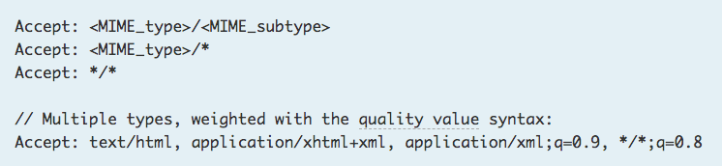
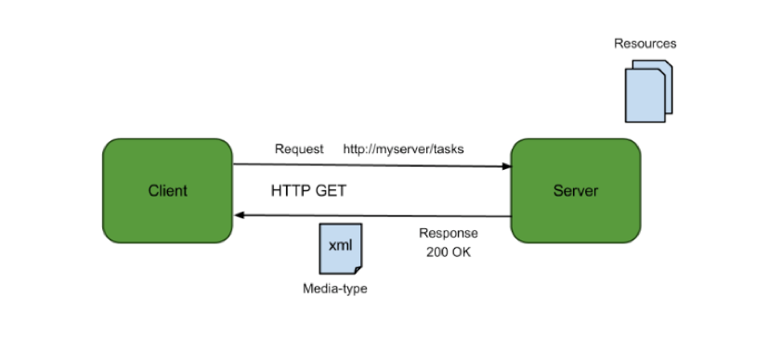
Resources, URLs, Content Types
Relative URL identifies “resource” on the server.
Server implementation maps abstract resource to tangible “thing,” file, DB row, … and any application logic.
Accept type in headers.
Client may be
Browser
Mobile device
Other REST Service
… …
Web media (content) type, e.g.
text/html
application/json

Slide 24
REST Principles
What about all of those principles?
Client/Server
Stateless
Cacheable
Uniform Interface
Layered System
Code on demand
Some of these principles
Are simple and obvious.
Are subtle and have major implications.
Stateless can be baffling, but we will cover later.
We will go into the principles in later lectures, ... but first linked resources ... ...

Slide 25
GET
https://localhost:8001
ftp://
File:///
Sip://
https://classes.dff-e6156.org/students?last_name=Ferguson& select * from students where last_name=‘Ferguson’

Slide 26
/students (GET, POST)
/students/{uni} (PUT, GET, DELETE)
/projects
/coupons

Slide 27
Linked Data
27 | E6156 – Topics in SW Engineering: Cloud Computing: Lecture 2a – Microservices, REST, BLOBs © Donald F. Ferguson, 2023

Slide 28
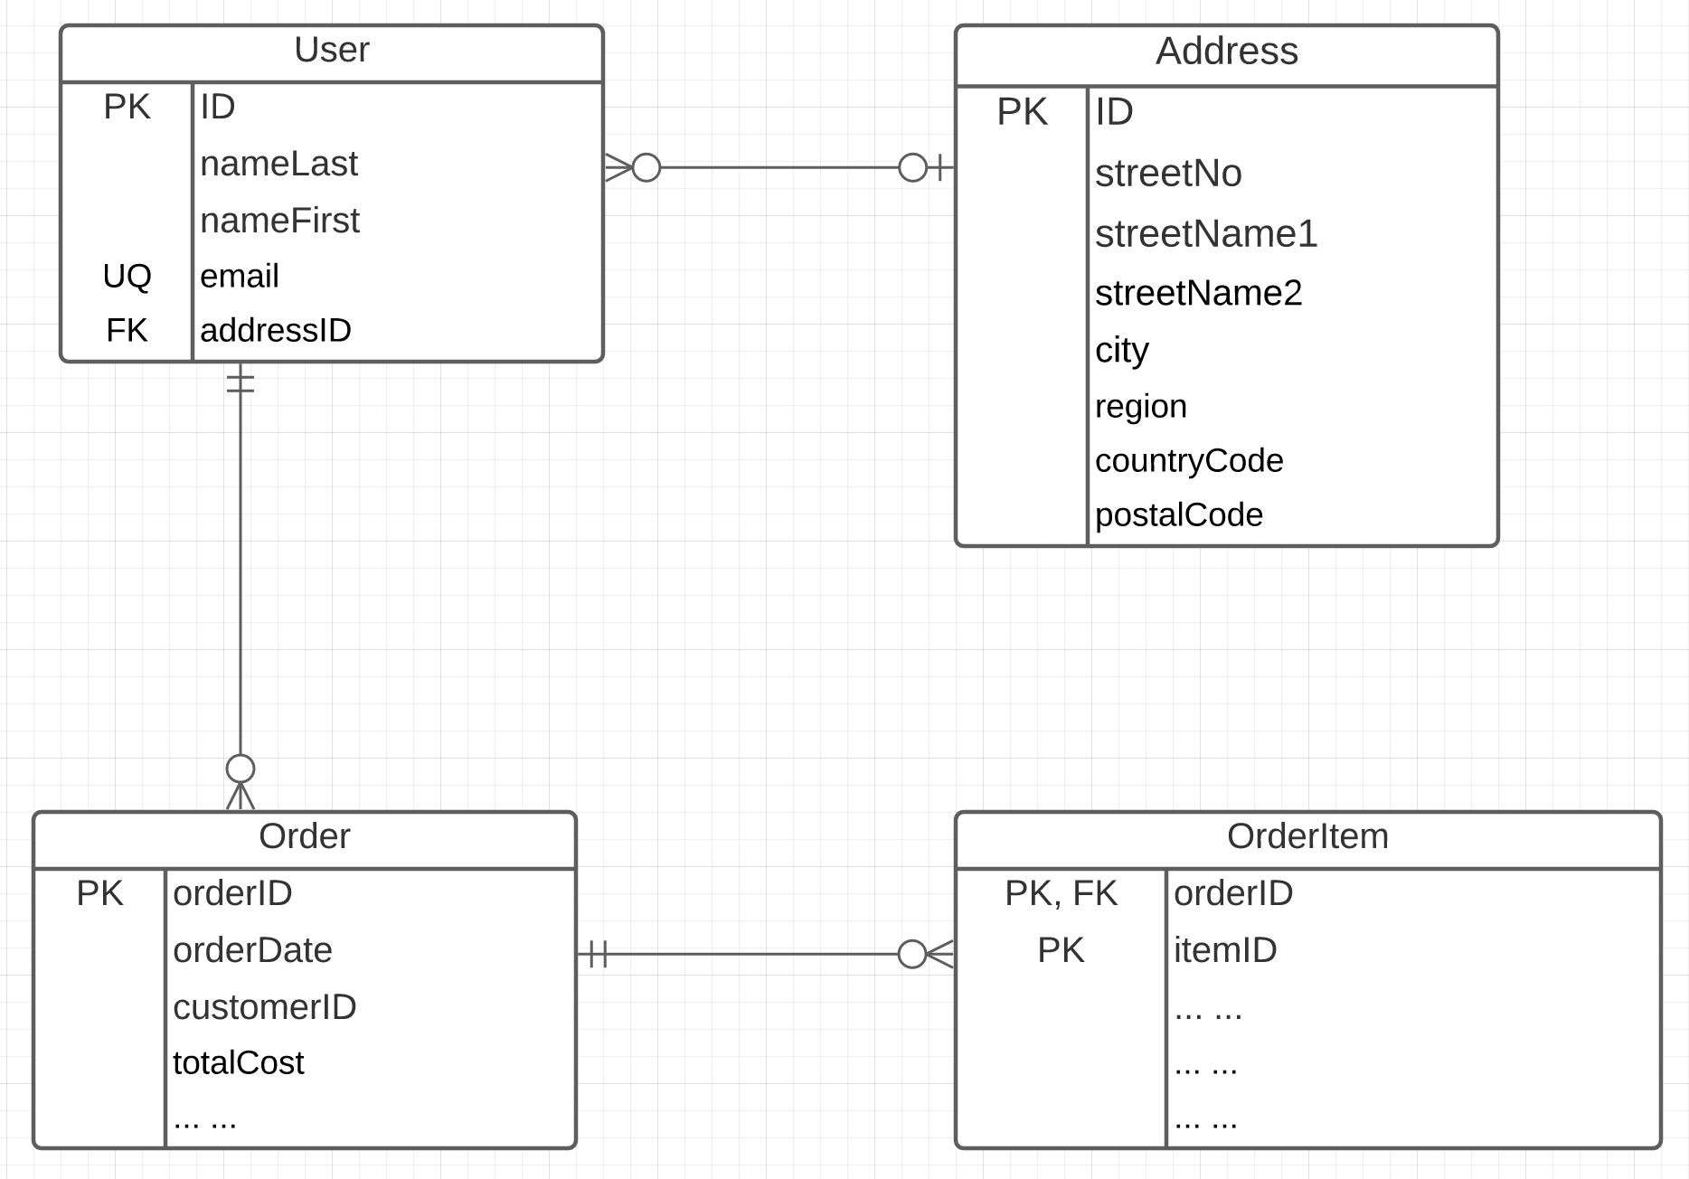
Linked Data
Consider two microservices:
UserService handles two resources:
User
Address
OrderService handles two resources:
Order
OrderItem
Associations/Link/Relationships can be surprisingly complicated. There are many considerations. (See https://www.uml-diagrams.org/association.html)
In this example, we have
Association (User-Address, User-Order)
Composition (Order-OrderItem)

Slide 29
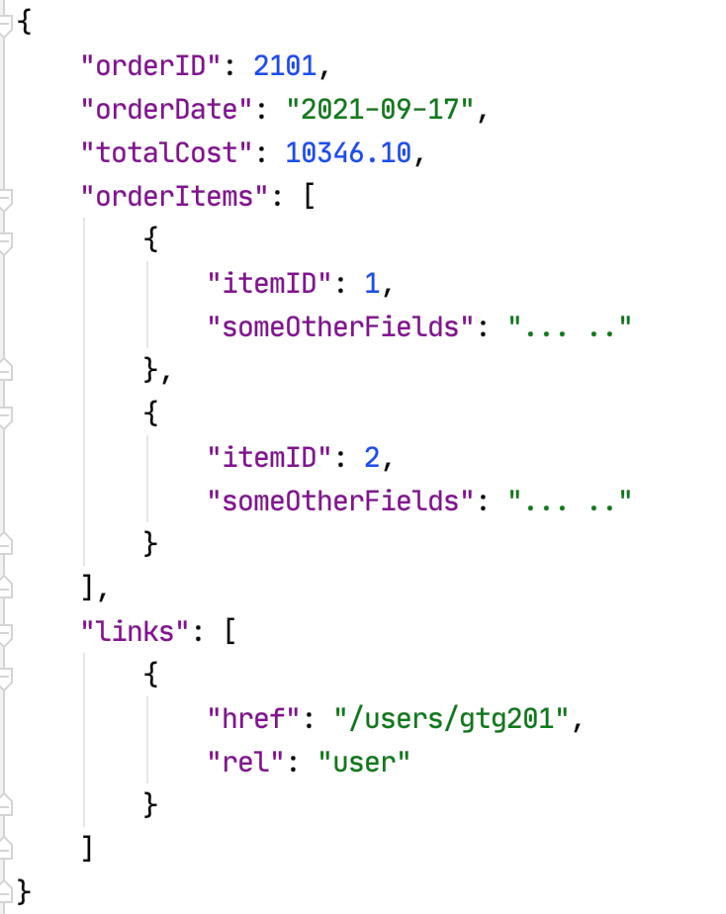
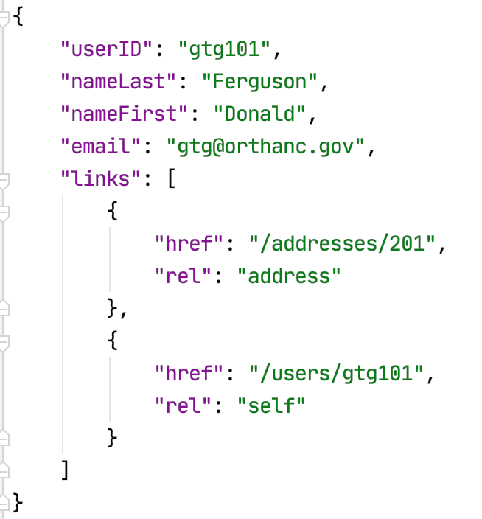
Resource Paths
The simple object model might/could/would/should have the following:
/users
/users/<userID>
/users/<userID>/address
/users/<userID>/orders
/addresses
/addresses/<addressID>/users
/orders/<orderID>
/orders/<orderID>/orderitems
/orders<orderID>/orderitems/<itemID>
... ...
How do you “point backwards” in a “foreign key relationship,” e.g. Address → User
“href” : “/users?addressID=201”
This means you store the addressID in the DB but return a link om REST.
Composition
Association

Slide 30
Example
30 | E6156 – Topics in SW Engineering: Cloud Computing: Lecture 2a – Microservices, REST, BLOBs © Donald F. Ferguson, 2023

Slide 31
Examples
SwaggerHub
FastAPI and Pydantic examples.
/Users/donaldferguson/Dropbox/000-NewProjects/W4111-FastAPI-IMDB-Solution

Slide 32
BLOBs, AWS S3, Web Server
32 | E6156 – Topics in SW Engineering: Cloud Computing: Lecture 2 – Microservices, REST, Containers, PaaS, S3 © Donald F. Ferguson, 2021

Slide 33
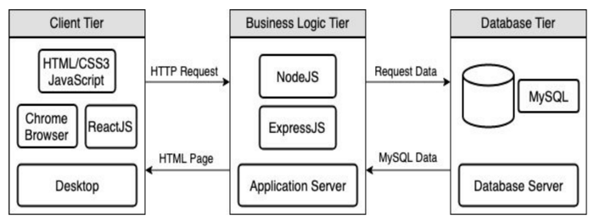
Full Stack Web Application – Reminder
https://levelup.gitconnected.com/a-complete-guide-build-a-scalable-3-tier-architecture-with-mern-stack-es6-ca129d7df805
We have seen how to use Flask (or FastAPI) to implement an endpoint (a set of paths):
Some of the paths can run application logic and return the result data.
Some can return pages that a browser can render. Basically, these paths are returning the “client application” to the browser to execute, and may have API calls in JavaScript/Typescript.
Do not worry about this now.
But, running application logic and simply delivering files are two different “concerns.”
Having one runtime implement both would violate the SOLID principle.
The design points are different: “You can be a floor wax or a mouth wash, but not both.”
So, we need a separate “web server.”

Slide 34
Reminder and Positioning
Explaining:
S3 and web hosting.
CloudFront:
Domain
Single site

Slide 35
BLOB: Binary Large Object
Definitions:
“A binary large object (BLOB or blob) is a collection of binary data stored as a single entity. Blobs are typically images, audio or other multimedia objects, though sometimes binary executable code is stored as a blob. They can exist as persistent values inside some databases or version control system, or exist at runtime as program variables in some programming languages.” (https://en.wikipedia.org/wiki/Binary_large_object)
“Blob is the data type in MySQL that helps us store the object in the binary format. It is most typically used to store the files, images, etc media files for security reasons or some other purpose in MySQL.” (https://www.educba.com/mysql-blob/)
Intent:
File systems are not good for many application scenarios, which is why database management systems emerged.
Database management systems implement structured (or semi-structured) data, e.g. tables.
Database BLOBs were a way to have some “big things” as table or document properties.

Slide 36
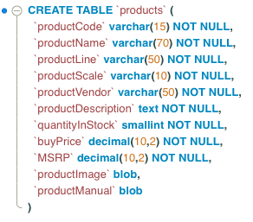
Simple Example
Structured or semi-structured information about an entity.
Queryable
Editable on forms
etc.
Unstructured: A file-like, opaque property associated with the entity. This is a BLOB.
URLs have primarily replaced BLOBs.

Slide 37
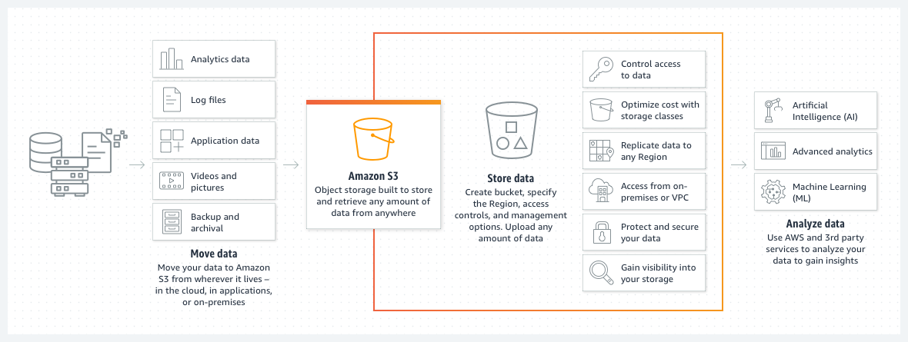
Amazon S3
We used the equivalent capability on Azure for uploading CAD files, storing processed files and results, etc.

Slide 38
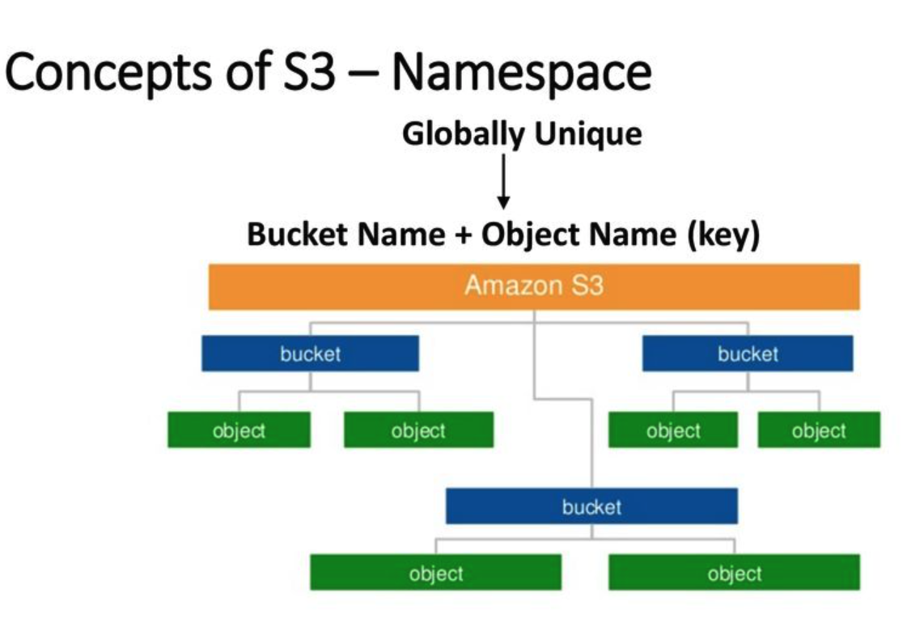
AWS S3
Can support a logical hierarchy with a convention on keys.
x/y
x/z
x/y/z
... ...
Acts kind of file system like, but is really just key strings.

Slide 39
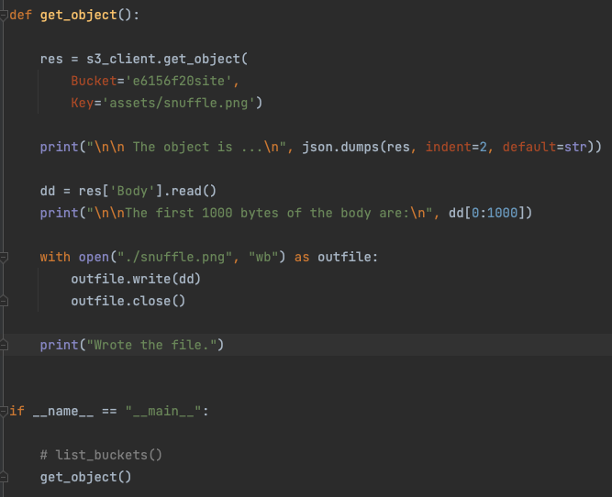
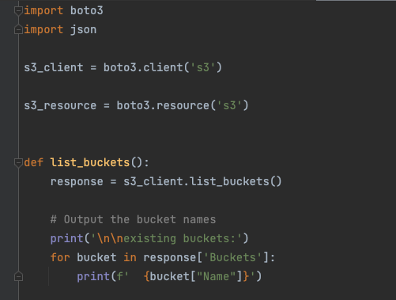
Simple S3 Example
/Users/donaldferguson/Dropbox/00NewProjects/e6156examples/s3/s3_examples.py

Slide 40
Simple S3 Example
Will worry about APIs to S3 later.
/Users/donaldferguson/Dropbox/00NewProjects/e6156examples/s3/s3_examples.py

Slide 41
Walkthrough
CloudFront
Distribution d2eakloxxxvksx.cloudfront.net
Origins
Behaviors
Enablement:
Route 53 Domain and DNS
Certificate and HTTPS
S3:
https://s3.console.aws.amazon.com/s3/buckets/dff-class-dashboard?region=us-east-1&tab=objects
Deployment and buckets.
Policy

